Slide 1
Chapter 3: Problem Solving by Searching
Artificial Intelligence
30 September 2020
1

Slide 2
Introduction
Problems are the issues which comes across any system.
A solution is needed to solve that particular problem.
Problem solving, particularly in artificial intelligence, may be characterized as a systematic search through a range of possible actions in order to reach some predefined goal or solution.
30 September 2020
2

Slide 3
Four general steps in problem solving:
Goal formulation
Helps to organize behavior by isolating and representing the task knowledge necessary to solve problem,
What are the successful world states
Problem formulation
What actions and states to consider given the goal, Define the problem precisely with initial states, final state and acceptable solutions.
Search
Determine the possible sequence of actions that lead to the states of known values and then choosing the best sequence.
Execute
Once the search algorithm returns a solution to the problem, the solution is then executed by the agent
Give the solution perform the actions.
30 September 2020
3

Slide 4
Problem formulation
Well-defined problems: Problems where the goal or solution is recognizable--where there is a right answer.
A problem is defined by:
An initial state: State from which agent start
Operator or Successor function: Description of possible actions available to the agent.
Goal test: Determine whether the given state is goal state or not
Path cost: Sum of cost of each path from initial state to the given state.
A problem when defined with these components is called well defined problem.
A solution is a sequence of actions from initial to goal state. Optimal solution has the lowest path cost.
30 September 2020
4

Slide 5
State Space representation
The state space is commonly defined as a directed graph in which each node is a state and each arc represents the application of an operator transforming a state to a successor state.
A solution is a path from the initial state to a goal state.
30 September 2020
5

Slide 6
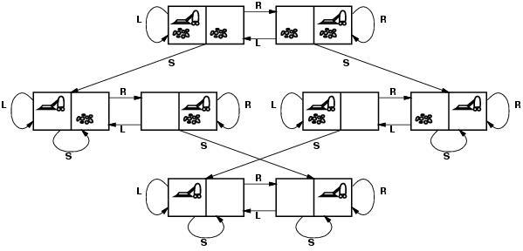
State Space representation of Vacuum World Problem
30 September 2020
6

Slide 7
Problem Formulation of Vacuum World
Problem
States?? two locations with or without dirt: 2 x 2²=8 states.
Eg [A,Dirty]
Initial state?? Any state can be initial
Actions?? {Left, Right, Vacuum}
Goal test?? Check whether squares are clean.
Path cost?? Number of actions to reach goal.
30 September 2020
7

Slide 8
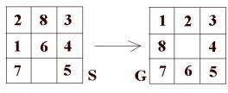
The 8-puzzle problem
State: location of blank
Operator: blank moves left, right, up and down
Goal Test: match G
Path Cost: each step costs 1 so cost is l
ength of path
30 September 2020
8

Slide 9
What is Search?
Search is the systematic examination of states to find path from the start/root state to the goal state.
The set of possible states, together with operators defining their connectivity constitute the search space.
The output of a search algorithm is a solution, that is, a path from the initial state to a state that satisfies the goal test.
In real life search usually results from a lack of knowledge. In AI too search is
merely a offensive instrument with which to attack problems that we can't seem to solve any better way.
Search techniques fall into three groups:
Methods which find any start - goal path,
Methods which find the best path, and finally
Search methods in the face of adversaries.
30 September 2020
9

Slide 10

Graph
Figure below contains a representation of a map.
The nodes represent cities, and the links represent direct road connections between cities.
The number associated to a link represents the length of the corresponding road.
The search problem is to find a path from a city S to a city G
A graph representation of a map is shown below:
30 September 2020
10

Slide 11
Search trees
The map of all paths within a state-space is a graph of nodes which are connected by links.
We can trace out all possible paths through the graph to produce a search tree.
Like graphs, trees have nodes, but they are linked by branches. The start node is called the root and nodes at the other ends are leaves.
Nodes have generations of descendants. The first generation are children.
30 September 2020
11

Slide 12
These children have a single parent node, and the list of nodes back to the root is their ancestry.
A node and its descendants form a subtree of the node's parent.
If a node's subtrees are unexplored or only partially explored, the node is open, otherwise it is closed.
If all nodes have the same number of children, this number is the branching factor.
The aim of search is not to produce complete physical trees in memory, but rather explore as little of the virtual tree looking for root-goal paths.
30 September 2020
12

Slide 13
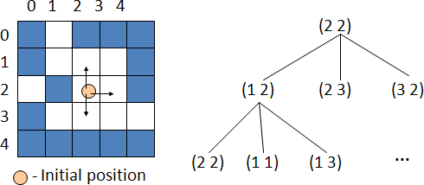
30 September 2020
13

Slide 14
Some of the most popularly used problem solving with the help of artificial intelligence are:
Sudoku
Chess
Travelling Salesman Problem
Water-Jug Problem
N-Queen Problem
Search problems are part of a large number of real world applications:
Path planning
Robot navigation
VLSI layout, etc.
30 September 2020
14

Slide 15
In general, searching refers to as finding information one needs.
Searching is the most commonly used technique of problem solving in artificial intelligence.
The searching algorithm helps us to search for solution of particular problem.
30 September 2020
15

Slide 16
Measuring problem Solving Performance
We will evaluate the performance of a search algorithm in four ways
Completeness: An algorithm is said to be complete if it definitely finds solution to the problem, if exist.
Time Complexity: How long (worst or average case) does it take to find a solution? Usually measured in terms of the number of nodes expanded
Space Complexity: How much space is used by the algorithm? Usually measured in terms of the maximum number of nodes in memory at a time
Optimality/Admissibility: If a solution is found, is it guaranteed to be an optimal one? For example, is it the one with minimum cost?
30 September 2020
16

Slide 17
Time and space complexity are measured in terms of
b -- maximum branching factor (number of successor of any node) of the search tree
d -- depth of the least-cost solution
m -- maximum length of any path in the space
30 September 2020
17

Slide 18
Uninformed (Blind) Search
In the case of uninformed search methods, the order in which potential solution paths are considered is arbitrary, using no domain- specific information to judge where the solution is likely to lie.
Various blind searches are:
Depth First Search
Breadth First Search
Depth Limited Search
Iterative Deepening Search
Uniform Cost Search
Bidirectional Search
30 September 2020
18

Slide 19
Informed (Heuristic) Search
In the case of informed search methods, one uses domain-dependent (heuristic) information in order to search the space more efficiently.
Ways of using heuristic information:
Deciding which node to expand next, instead of doing the expansion in a strictly breadth-first or depth-first order;
In the course of expanding a node, deciding which successor or successors to generate, instead of blindly generating all possible successors at one time;
Deciding that certain nodes should be discarded, or pruned, from the search space.
Why Use Heuristic Searches?
It may be too resource intensive (both time and space) to use a blind search
Even if a blind search will work we may want a more efficient search method
30 September 2020
19

Slide 20
Informed Search uses domain specific information to improve the search pattern
Define a heuristic function, h(n), that estimates the "goodness" of a node n.
Specifically, h(n) = estimated cost (or distance) of minimal cost path from n to a goal state.
The heuristic function is an estimate, based on domain-specific information that is computable from the current state description, of how close we are to a goal.
Various Informed Search Techniques are:
Greedy Best First Search
A* Search
Hill Climbing Search
Simulated Annealing Search
30 September 2020
20

Slide 21
Game Search/ Adversarial Search
Games are a form of multi-agent environment
What do other agents do and how do they affect our success?
Cooperative vs. competitive multi-agent environments.
Competitive multi-agent environments give rise to adversarial search often known as games
Games – adversary
Solution is strategy (strategy specifies move for every possible opponent reply).
Time limits force an approximate solution
Evaluation function: evaluate the goodness of game position
30 September 2020
21

Slide 22
Examples: chess, checkers, Othello, etc.
In search space of a game it represents the moves of two (or more) players, whereas in the search space of a problem it represents the "moves" of a single problem-solving agent.
Various Adversarial Search Techniques are:
Mini-max Search
Alpha-Beta Pruning
30 September 2020
22

Slide 23
Breadth First Search
All nodes are expanded at a given depth in the search tree before any nodes at the next level are expanded until the goal reached.
Expand shallowest unexpanded node (node with least depth).
implemented as a FIFO queue
In this technique you search for the goal node among all nodes of a particular generation before expanding further.
This way you always catch the node nearest the root in generations.
30 September 2020
23

Slide 24
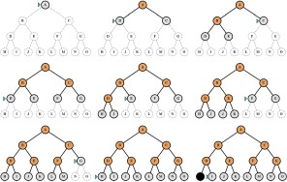
Breadth-first search (BFS)
BFS: Expand shallowest node first
30 September 2020
24

Slide 25
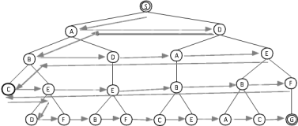
As the name BFS suggests, you are required to traverse the graph breadthwise as follows:
First move horizontally and visit all the nodes of the current layer (level)
Move to the next layer (level)
30 September 2020
25

Slide 26
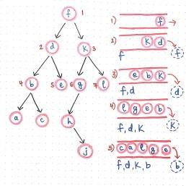
Breadth-first algorithm
1. Form a one element queue Q consisting of the root node.
2. Until the Q is empty or the goal has been reached, determine if the first element in the Q is the goal.
2a. If it is, do nothing.
2b. If is isn't, remove the first element from the Q, and add the first element's children, if any, to the BACK of the Q.
3. If the goal is reached, success; else failure.
30 September 2020
26

Slide 27
BFS Evaluation
Completeness:
Does it always find a solution if one exists?
YES, if shallowest goal node is at some finite depth d and if branching factor b
is finite
Time complexity:
Assume a state space where every state has b successors.
root has b successors, each node at the next level has again b successors (total b²), …
Assume solution is at depth d
Worst case; expand all except the last node at depth d
Total no. of nodes generated:
b + b² + b³ + ………………….. b^{d} + ( b^{d+1} –b) = O(b^{d+1})
30 September 2020
27

Slide 28
Space complexity:
Each node that is generated must remain in memory
Total no. of nodes in memory:
1+ b + b² + b³ + ………………….. b^{d} + ( b^{d+1} –b) = O(b^{d+1})
Optimal (i.e., admissible):
Optimal only if all paths have the same cost.
Otherwise, not optimal but finds solution with shortest path length (shallowest solution).
If each path does not have same path cost shallowest solution may not be optimal
30 September 2020
28

Slide 29
Two lessons:
Memory requirements are a bigger problem than its execution time.
Exponential complexity search problems cannot be solved by uninformed search methods for any but the smallest instances
Performance Measures
Completeness: Yes
Time efficiency: No
Space efficiency: No
Optimality: No
30 September 2020
29

Slide 30
Depth First Search
Looks for the goal node among all the children of the current node before using the sibling of this node i.e. expand deepest unexpanded node.
implemented as a LIFO queue (=stack)
The DFS algorithm is a recursive algorithm that uses the idea of backtracking.
It involves exhaustive searches of all the nodes by going ahead, if possible, else by backtracking.
Here, the word backtracking means that when you are moving forward and there are no more nodes along the current path, you move backwards on the same path to find nodes to traverse.
All the nodes will be visited on the current path till all the unvisited nodes have been traversed after which the next path will be selected.
30 September 2020
30

Slide 31
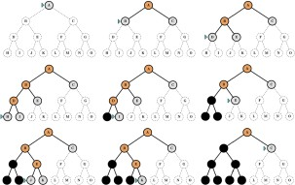
Depth-first Search (DFS)
DFS: Expand deepest node first
30 September 2020
31

Slide 32
DFS Evaluation
Completeness: Does it always find a solution if one exists?
NO, if search space is infinite and search space contains loops then DFS may not find solution.
Time complexity;
Let m is the maximum depth of the search tree.
In the worst case, Solution may exist at depth m.
root has b successors, each node at the next level has again b successors (total b²), …
Worst case; expand all except the last node at depth m
Total no. of nodes generated:
b + b² + b³ + ………………….. b^{m} = O(b^{m})
30 September 2020
32

Slide 33
Space complexity:
It needs to store only a single path from the root node to a leaf node, along with remaining unexpanded sibling nodes for each node on the path.
Total no. of nodes in memory:
1+ b + b + b + ………………….. b m times = O(bm)
Optimal (i.e., admissible):
DFS expand deepest node first, if expands entire left sub-tree even if right sub-tree contains goal nodes at levels 2 or 3. Thus we can say DFS may not always give optimal solution.
30 September 2020
33

Slide 34
In short:
Depth-first search is simple, but is very unsatisfactory if the tree is unbalanced, with some leaves being at the end of much longer branches than others.
Completeness: No
Time efficiency: No
Space efficiency: Yes
Optimality: No
30 September 2020
34

Slide 35
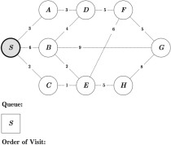
Exercise: BFS
30 September 2020
35

Slide 36
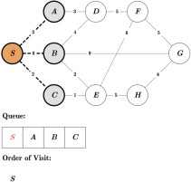
Exercise: BFS
30 September 2020
36

Slide 37
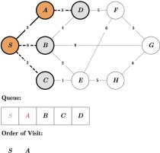
Exercise: BFS
30 September 2020
37

Slide 38
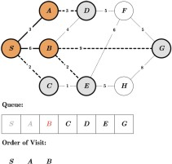
Exercise: BFS
30 September 2020
38

Slide 39
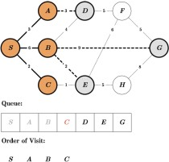
Exercise: BFS
30 September 2020
39

Slide 40
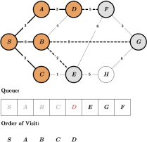
Exercise: BFS
30 September 2020
40

Slide 41
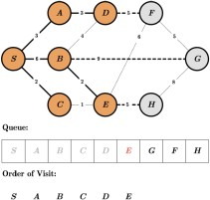
Exercise: BFS
30 September 2020
41

Slide 42
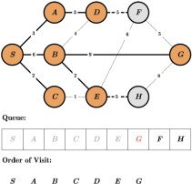
Exercise: BFS
30 September 2020
42

Slide 43
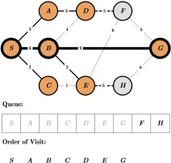
Exercise: BFS
30 September 2020
43

Slide 44
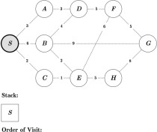
Exercise: DFS
30 September 2020
44

Slide 45
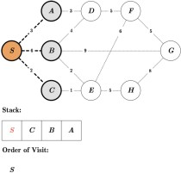
Exercise: DFS
30 September 2020
45

Slide 46
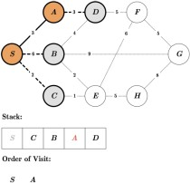
Exercise: DFS
30 September 2020
46

Slide 47
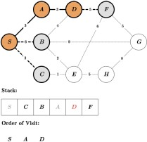
Exercise: DFS
30 September 2020
47

Slide 48
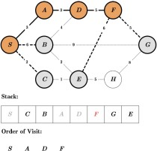
Exercise: DFS
30 September 2020
48

Slide 49
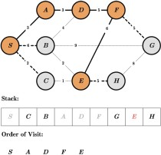
Exercise: DFS
30 September 2020
49

Slide 50
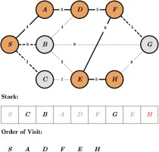
Exercise: DFS
30 September 2020
50

Slide 51
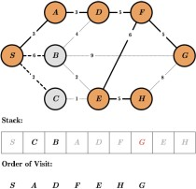
Exercise: DFS
30 September 2020
51

Slide 52
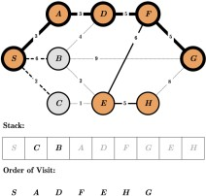
Exercise: DFS
30 September 2020
52

Slide 53
Depth Limited Search
The problem of unbounded trees can be solved by supplying depth- first search with a determined depth limit
nodes at certain depth are treated as they have no successors
is an uninformed search
modification of depth-first search and is used for example in the iterative deepening depth-first search algorithm.
It works exactly like depth-first search, but avoids its drawbacks regarding completeness by imposing a maximum limit on the depth of the search.
30 September 2020
53

Slide 54
Even if the search could still expand a vertex beyond that depth, it will not do so and thereby it will not follow infinitely deep paths or get stuck in cycles.
Therefore depth-limited search will find a solution if it is within the depth limit, which guarantees at least completeness on all graphs.
It solves the infinite-path problem of DFS.
30 September 2020
54

Slide 55
Yet it introduces another source of problem if we are unable to find good guess of maximum level of depth l.
Let d is the depth of shallowest solution (depth of goal node).
If l < d then incompleteness results.
If l > d then not optimal.
Time complexity: O( b^{l} )
Space complexity: O ( bl )
30 September 2020
55

Slide 56
Iterative Deepening Depth First Search
In this strategy, depth-limited search is run repeatedly, increasing the depth limit with each iteration until it reaches d, the depth of the shallowest goal state.
On each iteration, IDDFS visits the nodes in the search tree in the same order as depth-first search, but the cumulative order in which nodes are first visited is effectively breadth-first.
IDDFS combines depth-first search's space-efficiency and breadth-first search's completeness (when the branching factor is finite).
It is optimal when the path cost is a non-decreasing function of the depth of the node.
30 September 2020
56

Slide 57
Iterative deepening is depth-first search to a fixed depth in the tree being searched.
If no solution is found up to this depth then the depth to be searched is increased and the whole `bounded' depth-first search begun again.
It works by setting a depth of search -say, depth 1- and doing depth- first search to that depth.
If a solution is found then the process stops -otherwise, increase the depth by, say, 1 and repeat until a solution is found.
Note that every time we start up a new bounded depth search we start from scratch - i.e. we throw away any results from the previous search.
30 September 2020
57

Slide 58
Depth-first search can be implemented to be much cheaper than breadth- first search in terms of memory usage
However, depth-first search is not guaranteed to find a solution even where one is guaranteed.
On the other hand, breadth-first search can be guaranteed to terminate if there is a winning state to be found and will always find the `quickest' solution (in terms of how many steps need to be taken from the root node).
It is, however, breadth-first search is very expensive method in terms of memory usage.
Iterative deepening is liked because it is an effective compromise between the two other methods of search.
30 September 2020
58

Slide 59
It is a form of depth-first search with a lower bound on how deep the search can go.
Iterative deepening terminates if there is a solution.
It can produce the same solution that breadth-first search would produce but does not require the same memory usage (as for breadth-first search).
Note that depth-first search achieves its efficiency by generating the next node to explore only when this needed.
The breadth-first search algorithm has to grow all the search paths available until a solution is found -and this takes up memory.
Iterative deepening achieves its memory saving in the same way that depth- first search does -at the expense of redoing some computations again and again (a time cost rather than a memory one).
30 September 2020
59

Slide 60
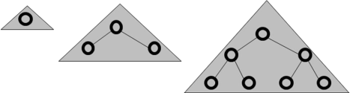
Complete (like BFS)
Has linear memory requirements (like DFS)
This is the preferred method for large state spaces, where the solution path length is unknown.
30 September 2020
60

Slide 61
Iterative Deepening search evaluation
Completeness:
YES (no infinite paths)
Time complexity:
Algorithm seems costly due to repeated generation of certain states.
Total no. of nodes generated: O(b^{d})
30 September 2020
61

Slide 62
Space complexity:
It needs to store only a single path from the root node to a leaf node, along with remaining unexpanded sibling nodes for each node on the path.
Total no. of nodes in memory:
1+ b + b + b + ………………….. b d times = O(bd)
Optimality:
YES if path cost is non-decreasing function of the depth of the node.
Notice that BFS generates some nodes at depth d+1, whereas IDS does not. The result is that IDS is actually faster than BFS, despite the repeated generation of node.
30 September 2020
62

Slide 63
Bidirectional Search
This is a search algorithm which replaces a single search graph, which is likely to with two smaller graphs –
One starting from the initial state and
Another one starting from the goal state
It then, expands nodes from the start and goal state simultaneously.
Check at each stage if the nodes of one have been generated by the other, i.e, they meet in the middle.
If so, the path concatenation is the solution.
30 September 2020
63

Slide 64
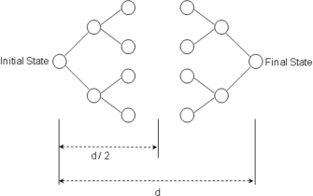
Completeness: YES
Optimality: YES (If done with correct strategy- e.g. breadth first and paths have the same cost)
Time complexity: O(b^{d/2})
Space complexity: O(b^{d/2})
30 September 2020
64

Slide 65
Drawbacks of uniformed search :
Criterion to choose next node to expand depends only on a global criterion: level or depth.
One may prefer to use a more flexible rule, that takes advantage of what is being discovered on the way, and hunches about what can be a good move.
Very often, we can select which rule to apply by comparing the current state and the desired state but uninformed search does not provide this feature.
30 September 2020
65

Slide 66
Heuristic Search:
Heuristic Search Uses domain-dependent (heuristic) information in order to search the space more efficiently.
Ways of using heuristic information:
Deciding which node to expand next, instead of doing the expansion in a strictly breadth-first or depth-first order;
In the course of expanding a node, deciding which successor or successors to generate, instead of blindly generating all possible successors at one time;
Deciding that certain nodes should be discarded, or pruned, from the search space.
30 September 2020
66

Slide 67
Heuristic Searches - Why Use?
It may be too resource intensive (both time and space) to use a blind search
Even if a blind search will work we may want a more efficient search method
Informed Search uses domain specific information to improve the search pattern
Define a heuristic function, h(n), that estimates the "goodness" of a node n.
Specifically, h(n) = estimated cost (or distance) of minimal cost path from n to a goal state.
The heuristic function is an estimate, based on domain-specific information that is computable from the current state description, of how close we are to a goal.
30 September 2020
67

Slide 68
Best-First Search
Idea: use an evaluation function f(n) that gives an indication of which node to expand next for each node.
usually gives an estimate to the goal.
the node with the lowest value is expanded first.
A key component of f(n) is a heuristic function, h(n),which is a additional knowledge of the problem.
There is a whole family of best-first search strategies, each with a different evaluation function.
Typically, strategies use estimates of the cost of reaching the goal and try to minimize it.
Special cases: based on the evaluation function.
Greedy best-first search
A*search
30 September 2020
68

Slide 69
Greedy Best First Search
The best-first search part of the name means that it uses an evaluation function to select which node is to be expanded next.
The node with the lowest evaluation is selected for expansion because that is the best node, since it supposedly has the closest path to the goal (if the heuristic is good).
Evaluation function f(n) = h(n) (heuristic) = estimate of cost from n to
goal.
e.g., h_{SLD}(n) = straight-line distance from n to goal
Greedy best-first search expands the node that appears to be closest to goal.
30 September 2020
69

Slide 70
The greedy best-first search algorithm is O(b^{m}) in terms of space and time complexity.
b is the average branching factor (the average number of successors from a state), and
m is the maximum depth of the search tree.)
Unlike A* which uses both the link costs and a heuristic of the cost to the goal, greedy best-first search uses only the heuristic, and not any link costs.
A disadvantage of this approach is that if the heuristic is not accurate, it can go down paths with high link cost since there might be a low heuristic for the connecting node.
30 September 2020
70

Slide 71
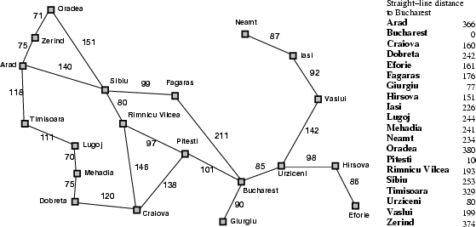
Example: Given following graph of cities, starting at Arad city, problem is to reach to the Bucharest.
30 September 2020
71

Slide 72

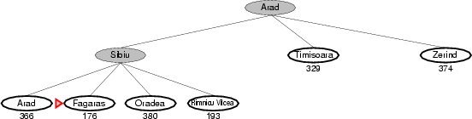
Solution using greedy best first can be as below:
30 September 2020
72

Slide 73
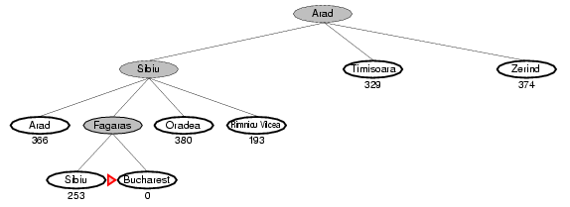
30 September 2020
73

Slide 74
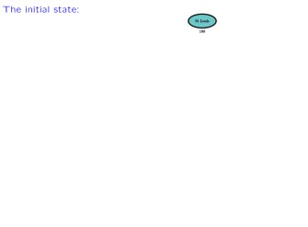
Greedy Search Example
30 September 2020
74

Slide 75
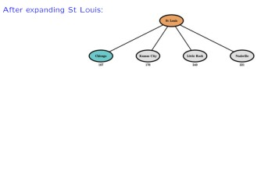
Greedy Search Example
30 September 2020
75

Slide 76
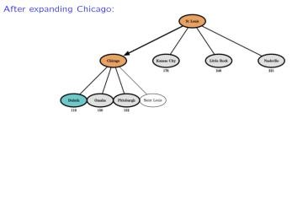
Greedy Search Example
30 September 2020
76

Slide 77
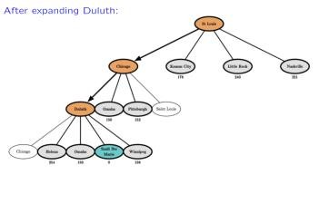
Greedy Search Example
30 September 2020
77

Slide 78
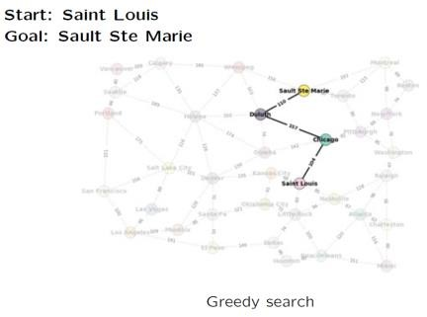
total cost:
104 + 157 + 110
= 371 kms
Example using the map
30 September 2020
78

Slide 79
Greedy Best-first search
minimizes estimated cost h(n) from current node n to goal;
is informed but (almost always) suboptimal and incomplete.
30 September 2020
79

Slide 80
A* search
A* is a best first, informed graph search algorithm.
A* is different from other best first search algorithms in that it uses a heuristic function h(x) as well as the path cost to the
node g(x), in computing the cost f(x) = h(x) + g(x) for the node.
The h(x) part of the f(x) function must be an admissible heuristic; that is, it must not overestimate the distance to the goal.
Thus, for an application like routing, h(x) might represent the straight-line distance to the goal, since that is physically the smallest possible distance between any two points or nodes.
30 September 2020
80

Slide 81
It finds a minimal cost-path joining the start node and a goal node for node n.
Evaluation function: f(n) = g(n) + h(n)
g(n) = cost so far to reach n from root
h(n) = estimated cost to goal from n
f(n) = estimated total cost of path through n to goal
combines the two by minimizing f(n) = g(n) + h(n);
is informed and, under reasonable assumptions, optimal and complete.
30 September 2020
81

Slide 82
As A* traverses the graph, it follows a path of the lowest known path, keeping a sorted priority queue of alternate path segments along the way.
If, at any point, a segment of the path being traversed has a higher cost than another encountered path segment, it abandons the higher-cost path segment and traverses the lower-cost path segment instead.
This process continues until the goal is reached
30 September 2020
82

Slide 83
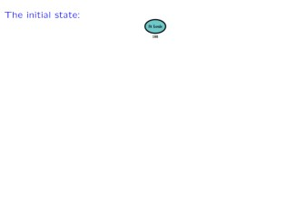
A* search example
30 September 2020
83

Slide 84
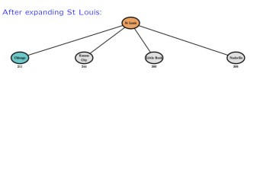
A* search example
30 September 2020
84

Slide 85
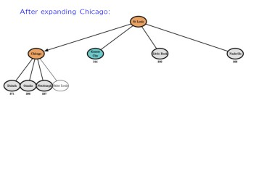
A* search example
30 September 2020
85

Slide 86
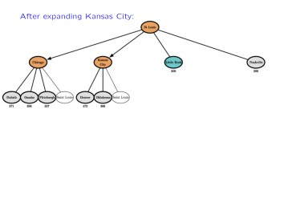
A* search example
30 September 2020
86

Slide 87
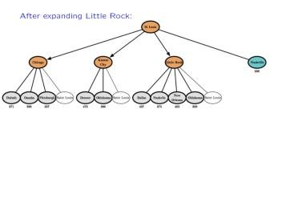
A* search example
30 September 2020
87

Slide 88
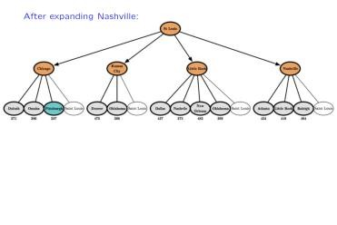
A* search example
30 September 2020
88

Slide 89
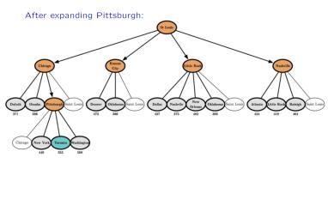
A* search example
30 September 2020
89

Slide 90
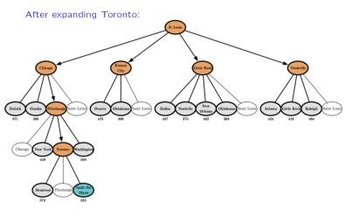
A* search example
30 September 2020
90

Slide 91
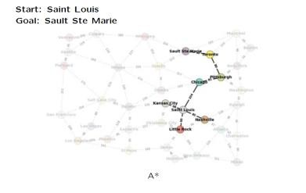
Example using map
A* total cost: 104 + 81+ 80 +
90 = 355 kms
greedy search total cost:
104 + 157 + 110
= 371 kms
30 September 2020
91

Slide 92
30 September 2020
92

Slide 93


30 September 2020
93

Slide 94
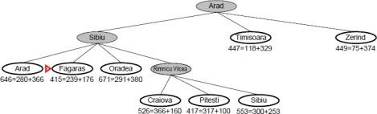
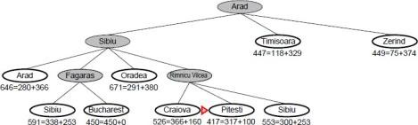
30 September 2020
94

Slide 95
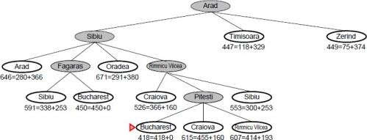
30 September 2020
95

Slide 96
Admissible heuristics
A good heuristic can be powerful, only if it is of a “good quality”
A good heuristic must be admissible
An admissible heuristic never overestimates the cost to reach the goal, that is it is optimistic
A heuristic h is admissible if
∀ 𝑛𝑜𝑑𝑒 𝑛, ℎ 𝑛 ≤ ℎ∗(𝑛)
where ℎ∗ is the true cost to reach the goal from 𝑛
30 September 2020
96

Slide 97
A heuristic function is said to be admissible if it is no more than the lowest-cost path to the goal.
In other words, a heuristic is admissible if it never overestimates the cost of reaching the goal.
An admissible heuristic is also known as an optimistic heuristic.
30 September 2020
97

Slide 98
Admissible heuristics
ℎ_{𝑆𝐿𝐷} (used as a heuristic in the map example) is admissible because it is by definition the shortest distance between two points.
blue = SLD red = actual
B
distance
SLD <= actual distance
A
so 𝒉_{𝑺𝑳𝑫} is an admissible heuristic
30 September 2020
98

Slide 99
A* search criteria
Complete: Yes
Time: exponential
Space: keeps every node in memory, the biggest problem
Optimal: Yes!
If 𝒉(𝒏) is admissible, A* using tree search is optimal.
30 September 2020
99

Slide 100
Hill Climbing Search
Hill climbing can be used to solve problems that have many solutions, some of which are better than others.
It starts with a random (potentially poor) solution, and iteratively makes small changes to the solution, each time improving it a little.
When the algorithm cannot see any improvement anymore, it terminates.
not guaranteed that hill climbing will ever come close to the optimal solution.
30 September 2020
100

Slide 101
For example, hill climbing can be applied to the traveling salesman problem.
It is easy to find a solution that visits all the cities but will be very poor compared to the optimal solution.
The algorithm starts with such a solution and makes small improvements to it, such as switching the order in which two cities are visited.
Eventually, a much better route is obtained.
In hill climbing the basic idea is to always head towards a state which is better than the current one.
So, if you are at town A and you can get to town B and town C (and your target is town D) then you should make a move IF town B or C appear nearer to town D than town A does.
30 September 2020
101

Slide 102
The hill climbing can be described as follows
Start with current-state = initial-state.
Until current-state = goal-state OR there is no change in current-state do:
Get the successors of the current state and use the evaluation function to assign a score to each successor.
If one of the successors has a better score than the current-state then set the new current-state to be the successor with the best score.
Hill climbing terminates when there are no successors of the current state which are better than the current state itself.
Hill climbing is depth-first search with a heuristic measurement that orders choices as nodes are expanded.
It always selects the most promising successor of the node last expanded.
30 September 2020
102

Slide 103
The difference between the hill climbing search method and the best first search method is the following one:
the best first search method selects for expansion the most promising leaf node of the current search tree;
the hill climbing search method selects for expansion the most promising successor of the node last expanded.
30 September 2020
103

Slide 104
Problems with Hill Climbing
Gets stuck at local minima when we reach a position where there are no better neighbors, it is not a guarantee that we have found the best solution. Ridge is a sequence of local maxima.
Another type of problem we may find with hill climbing searches is finding a plateau. This is an area where the search space is flat so that all neighbors return the same evaluation
30 September 2020
104

Slide 105
Simulated Annealing
It is motivated by the physical annealing process in which material is heated and slowly cooled into a uniform structure.
Compared to hill climbing the main difference is that SA allows downwards steps.
Simulated annealing also differs from hill climbing in that a move is selected at random and then decides whether to accept it.
If the move is better than its current position then simulated annealing will always take it.
If the move is worse (i.e. lesser quality) then it will be accepted based on some probability.
30 September 2020
105

Slide 106
The probability of accepting a worse state is given by the equation
P = exponential(-c /t) > r
c =
t =
r =
the change in the evaluation function the current value
a random number between 0 and 1
The probability of accepting a worse state is a function of both the current value and the change in the cost function.
The most common way of implementing an SA algorithm is to implement hill climbing with an accept function and modify it for Simulated Annealing
30 September 2020
106

Slide 107
By analogy with this physical process, each step of the SA algorithm replaces the current solution by a random "nearby" solution, chosen with a probability that depends on the difference between the corresponding function values and on a global parameter T (called the temperature), that is gradually decreased during the process.
The dependency is such that the current solution changes almost randomly when T is large, but increasingly "downhill" as T goes to zero.
The allowance for "uphill" moves saves the method from becoming stuck at local optima—which are the bane of greedier methods.
30 September 2020
107

Slide 108
Game Search
Games are a form of multi-agent environment
What do other agents do and how do they affect our success?
Cooperative vs. competitive multi-agent environments.
Competitive multi-agent environments give rise to adversarial search often known as games
Games – adversary
Solution is strategy (strategy specifies move for every possible opponent reply).
Time limits force an approximate solution
Evaluation function: evaluate ―goondess‖ of game position
Examples: chess, checkers, Othello, backgammon
30 September 2020
108

Slide 109
Difference between the search space of a game and the search space of a problem:
In the first case it represents the moves of two (or more) players, whereas in the latter case it represents the "moves" of a single problem-solving agent.
30 September 2020
109

Slide 110
Tic-tac-toe
There are two players denoted by X and O. They are alternatively writing their
letter in one of the 9 cells of a 3 by 3 board. The winner is the one who succeeds in writing three letters in line.
The game begins with an empty board. It ends in a win for one player and a loss for the other, or possibly in a draw.
A complete tree is a representation of all the possible plays of the game. The root node is the initial state, in which it is the first player's turn to move (the player X).
The successors of the initial state are the states the player can reach in one move,
their successors are the states resulting from the other player's possible replies, and so on.
Terminal states are those representing a win for X, loss for X, or a draw.
Each path from the root node to a terminal node gives a different complete play of the game. Figure given below shows the initial search space of Tic-Tac-Toe.
30 September 2020
110

Slide 111
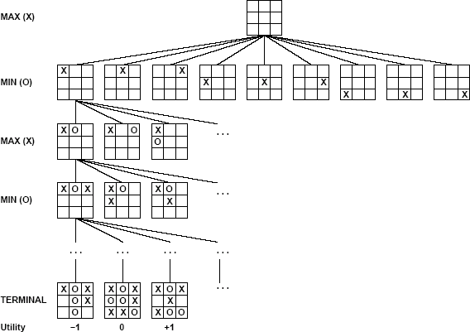
30 September 2020
111

Slide 112
A game can be formally defined as a kind of search problem as below
Initial state: It includes the board position and identifies the playesr to move.
Successor function: It gives a list of (move, state) pairs each indicating a legal move and resulting state.
Terminal test: This determines when the game is over. States where the game is ended are called terminal states.
Utility function: It gives numerical value of terminal states. E.g. win (+1), loose (- 1) and draw (0). Some games have a wider variety of possible outcomes eg. ranging from +92 to -192.
30 September 2020
112

Slide 113
The Minimax Algorithm
Let us assign the following values for the game: 1 for win by X, 0 for draw, -1 for loss by X.
Given the values of the terminal nodes (win for X (1), loss for X (-1), or draw (0)), the values of the non-terminal nodes are computed as follows:
the value of a node where it is the turn of player X to move is the maximum of the values of its successors (because X tries to maximize its outcome);
the value of a node where it is the turn of player O to move is the minimum of the values of its successors (because O tries to minimize the outcome of X).
30 September 2020
113

Slide 114
Figure below shows how the values of the nodes of the search tree are computed from the values of the leaves of the tree. The values of the leaves of the tree are given by the rules of the game: ·
1 if there are three X in a row, column or diagonal;
-1 if there are three O in a row, column or diagonal;
0 otherwise
30 September 2020
114

Slide 115
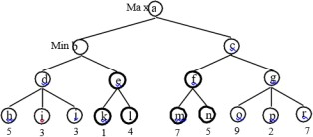
An Example
Consider the following game tree (drawn from the point of view of the Maximizing player):
30 September 2020
115

Slide 116
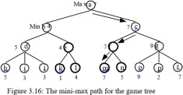
Show what moves should be chosen by the two players, assuming that both are using the mini-max procedure.
Solution:
30 September 2020
116

